Slide 1

BCA Ist Semester Introduction of Logic Circuit and Digital Design(ILCDD) Course Code: BCAC003
Presented by:
Mr.Anuj Kumar
Assistant Professor, Dept. Of CE&A
GLA University, Mathura

Slide 2
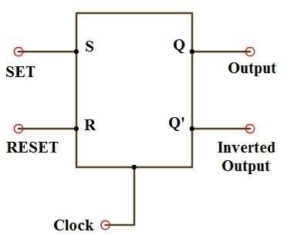
RS (or) SR Flip-Flop
The S-R flip-flop is basic flip-flop among all the flip-flops.
All the other flip flops are developed after SR-flip-flop.
SR flip-flop operates with only positive clock transitions (or) negative clock transitions.
Whereas, SR latch operates with enable signal.

Slide 3
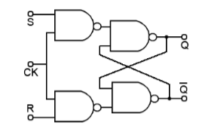
The circuit diagram of SR flip-flop is shown in the following figure.
This circuit has two inputs S & R and two outputs Q & Q’. The
operation of SR flip flop is similar to SR Latch.
Consider, this flip-flop affects the outputs only when positive transition of the clock signal is applied instead of active enable.

Slide 4
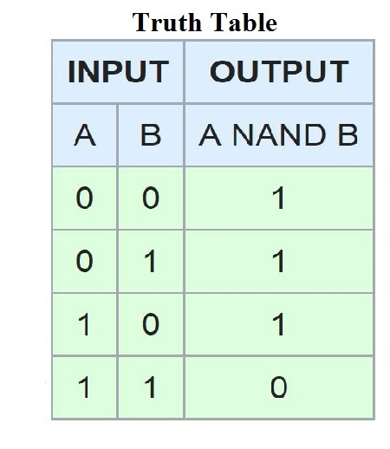
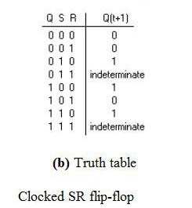

Slide 5
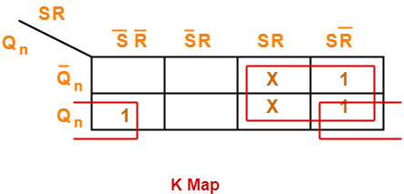
Characterstics Equation= S+QR’

Slide 6
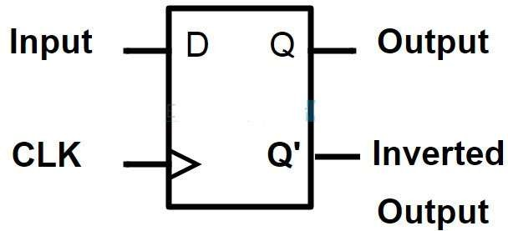
D Flip-Flop
D flip – flop has two inputs , and two outputs
a clock (CLK) input and
a data (D) input
And outputs are
one is main output represented by Q and
the other is complement of Q represented by Q’.
The symbol of a D flip – flop is shown below.

Slide 7
D flip – flops are also called as “Delay flip – flop” or “Data flip – flop”.
They are used to store 1 – bit binary data.
They are one of the widely used flip – flops in digital electronics.
D flip – flops are also considered as Delay line elements and Zero – Order Hold elements.
A D flip – flop is constructed by modifying an SR flip – flop.
The S input is given with D input and the R input is given with inverted D input.

Slide 8
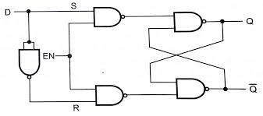
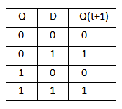
Construction & Logic Circuit
Characteristic table
NAND GATE Truth Table
Characterstics Equation= D

